Slide 1
2011 Security Strategy - DRAFT
April 1, 2011

Slide 2
Strategic Summary: Security
What is the Relevant Business Situation?
Background:
BAC is consistently recognized by outside 3rd parties as being a leader in security*
Research findings from a cross-functional enterprise security messaging team formed early 2010 helped guide the development of the $0 Liability Guarantee as a Broad Bet; security continues to play an important role in BAC’s business and brand objectives: Foundational in building Trust; Encourages use of e-Channels; Improved Satisfaction and willingness to adopt OLB features.
Fraud cost to the bank forecasted to be $12MM in 2011 – security programs critical to fraud cost reduction
*BAC online security has ranked #1 on Javelin scorecard 6 years consecutively
What is the Problem or Opportunity?
Problem Statement:
Customer perception does not reflect BAC’s actual strength in security protection; VOC shows that Security concerns are the #1 or #2 barrier to online/self-service adoption.**
While the Bank’s layered security strategy does a great job of protecting customers within its OLB/firewalls, customers don’t fully understand the level of potential risk that Malware and other viruses present. Personal I.D. theft is the #1 crime in the U.S. 1 in 3 Americans have experienced personal fraud.
There is a need to educate customers about how they can do more to protect their personal information when on BAC and external sites Customers need to understand that they have a responsibility to take action on behalf of their personal online security.
Current online environment offers a myriad of security solutions to customers but does not offer a comprehensive view of optimal security protection
**Source: internal VOC and 2009 Javelin Strategy and Research ‘Online Banking and Bill Payment Forecast’ study
2
Bank of America: Confidential

Slide 3
Strategic Summary: Security
Goals: 1) Increase adoption of online self-service products leading to relationship deepening via providing customers with enhanced security experience 2) Education – balance how to show customers the security benefits of banking with BAC as well as the additional products they can take advantage of to improve overall security 3) Fraud cost mitigation 3) Revenue impact
Proposed Solution - Develop a marketing strategy that supports eCommerce overall multi-gen security strategy, specifically:
Education - give customers an easy way to show what security features they have and what they need; help customers understand how they can leverage the bank’s layered security strategy to protect their personal information when online; provide overview of a customer’s individual security ‘status’
Product awareness and consideration - proactively extend new security software offerings to customers; reward OLB customers with free “Best in Class” software to protect their online experience and privacy; differentiate between security software offers (Trusteer vs McAfee)
Current state:
Integration into the 2011 Customer Engagement strategy: VOC shows correlation between Security and Deepening; As part of the customer deepening programs, we will leverage holistic security messaging to generate awareness of security features like Site Key and Safe Pass, with special emphasis on software solutions from Trusteer and McAfee.
Future State:
Build an online ‘Security Solutions’ landing page that shows customers a comprehensive view of how they are protected and additional options they can take advantage of to improve their online security, both on BAC.com or any other site. The intent of the page is to: 1) drive awareness around BAC’s ‘best in class’ industry standing, and 2) drive awareness and product consideration around additional security options (i.e. Trusteer) and 3) provide customers with a better understanding of their overall security status and how their protection ‘ranks’
Integrate/align with 2011 priorities for streamlining content/site simplification – syndicated content that will improve and eventually replace current Security Center.
What do we want to do?
3
Bank of America: Confidential

Slide 4
Strategic Summary: Security
Why Should We Do It?
Customer Insight/Need:
Security is top need in VOC - customer base consistently rank security concerns as the #1 or #2 barrier to online/self-service channel adoption; positive VOC results for new security software (Trusteer and McAfee) show that anti-virus and Malware protection is important to customers and that they would download this type of software ; VOC also shows correlation between Security and Relationship Deepening
Customers need to understand what each of our security levels provide and that while the bank is premier in offering security solutions and is viewed as industry leader in security, protecting their personal information is also part of their responsibility
Security is a foundational demonstration and a customer need – consumers need and expect a financial institution to make them feel secure; aligns to Broad Bet around “Less Hassle” and $0 Liability Guarantee – customers are re-assured that ‘we have their back’
Customers need to be able to differentiate more clearly between Trusteer and McAfee and why they need both
How does our solution rank in the industry? BAC is consistently recognized by outside 3rd parties as being leader in security* (example: no other US retail bank offers additional software to its OLB customers to protect against Malware) but online functionality specific to ‘security solutions’ is not as navigable as Chase (example) but is more robust than Wells (see appendix for details).
Business Need : Consumer Protection & Fraud cost reduction (Fraud cost forecast for 2011 is $12MM down from $15MM+ in 2010); McAfee revenue share
Key Measurement – Units: # of downloads (Trusteer and McAfee); McAfee - # of renewal downloads; Revenue: Fraud mitigation benefit estimated at $1.07 for each Trusteer download; McAfee revenue share 20% or $7 per 1st annual renewal. Secondary Measures: number of unique customer visits to ‘Security Checklist’ page; CTR% to product pages from checklist page; increased adoption to online products and services by those who adopt security features.
4
Bank of America: Confidential

Slide 5
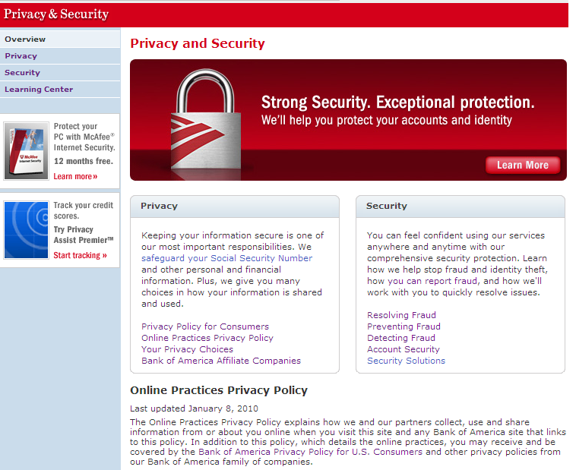
Current Site – adequate…but Customer Experience not optimal
Redesigned site (2010) – Improvements:
Incorporates updated design standards
Clearly delineates privacy & security topics
Simplifies language & reduces text
Security video created for landing page
(Jan 2011 – Mar 2011 ~ 6895 views)
BUT:
Does not accomplish goal of one-stop shop/comprehensive view
Does not easily show customers how products are relevant and what they can do to improve online security
Not easily navigable - see next slide

Slide 6
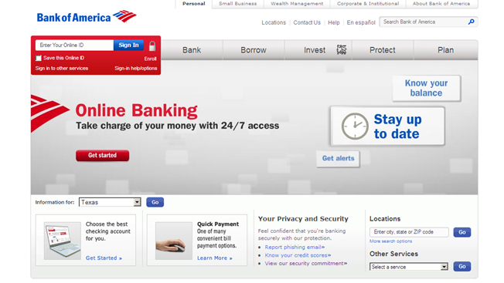
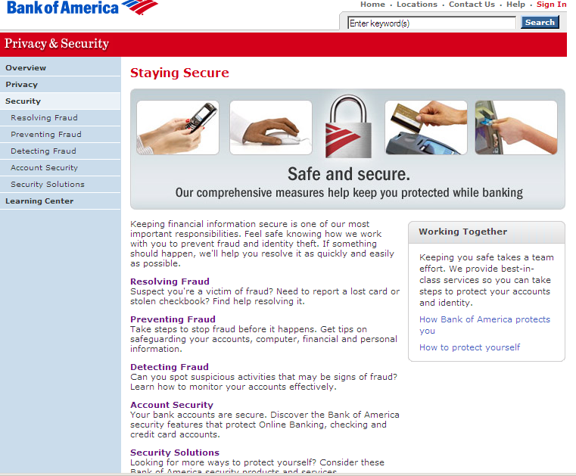
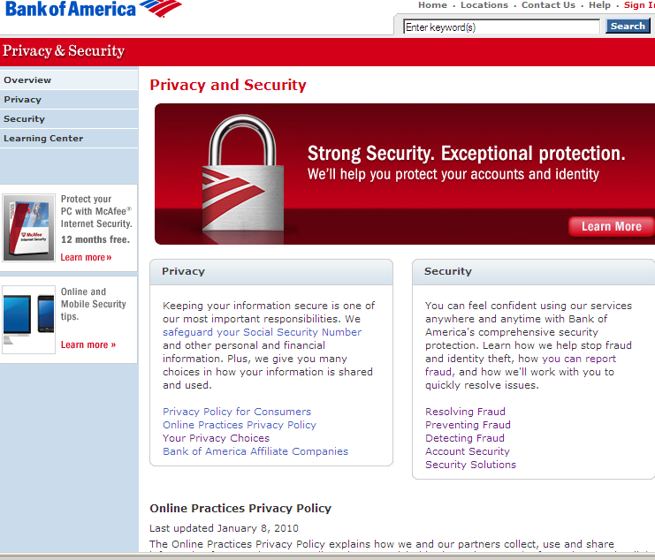
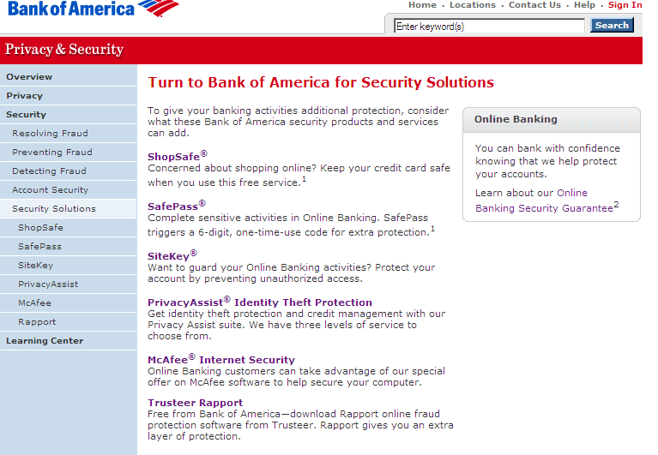
Customer Experience Today
Customers face a minimum of 3 clicks to find Security Solutions page
Placement on home page

Slide 7

Proposed Channel Brief
Channel Objectives
Awareness
Awareness: Create strong exposure and visibility for all security messages to ensure our customers know that Bank of America is dedicated and relentless about helping them with their security concerns.
Awareness Strategies: Find environments where people go to learn about protecting their online experiences. Reach out when customers may be more receptive, such as after a security event (stolen credit card, etc.), moving, change of life event (divorce, retirement, graduating from college).
Stimulation
Engagement
Connection
Education
Education: Start a dialog with customers regarding online security, transaction and transmission data. Tools to assess their personal security risk threshold and recommend a security level that fits their lifestyle.
Action
Education Strategies: Explore touch-points that come to mind when customers think about security (OLB sign in, online purchasing, password change, applying for credit). Interactive demo is recommended to showcase how simple it is to use security features, and how easy it is to enroll in optional services. Decisioning tool to determine best security for each customer.
Channel Strategy
Channel Strategy for Customer Experience Creation of a comprehensive security page to alleviate the issue of customer confusion about how products protect them. One single location to streamline enrollment and support. Authenticated upgrade experience to allow customers to easily upgrade to next level of security. Permanent site content/persistent linking strategy that will direct customers to comprehensive security page location.
Considered Channels
Onsite search, paid and natural search will reach customers when concerned with security. It is a hot button item when customers are thinking about security or when there has been a security event in their life. Customers will search for the information first, then browse.
Other Considerations
Messaging: Security messaging should be easy to find, but not overt or primary messaging; balanced between being secure and worrying about security.
Proposed CTAs: Landing page: Learn more about each individual security feature, enroll in optional features, download optional software
Other assets: To get started, go to the new security landing page
Enterprise Creative Solutions

Slide 8
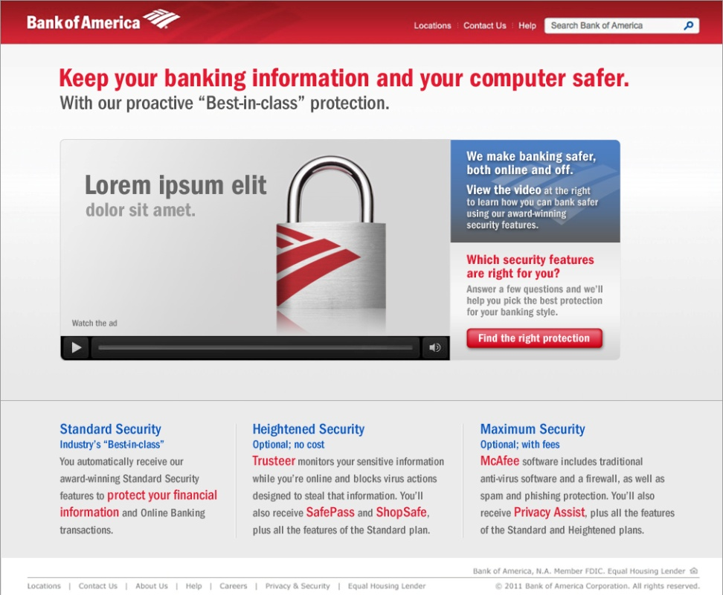
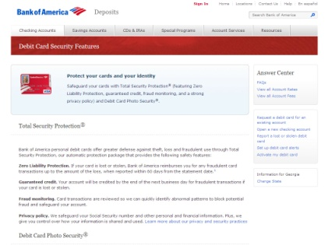
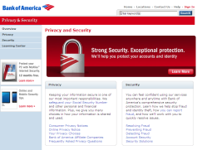
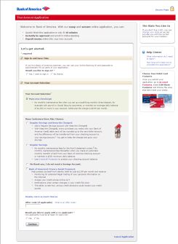
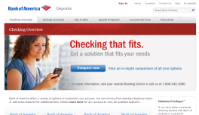
Recommendations
Generation 1
Online Security Center (1 stop shop):
Security content to educate customers about online security threats and products to thwart those threats
Assess customers’ security risk tolerance and recommend security packages
Product education to educate customers on how to use the products after enrollment
Individual security package pages (unauthenticated and authenticated versions)
Individual product information for the intermediate/advanced users
Optimized internal and external security searches
Integrated content in product areas, in OLB and Bill Pay and throughout the application processes
Generation 2
Check your security level: Authenticated (via SiteKey) to check a customers’ current security level, make recommendations to heighten security
Authenticated Security Center
SiteKey
Trusteer & McAfee product page
Security, Checking Overview & Applications
Enterprise Creative Solutions

Slide 9
Customer Experience Maps: Security Center
Learn
Choose
Use
Gen 1 (Unauthenticated)
Gen 2 (Authenticated)
Security Overview
Check your security level: Embedded in the authenticated environment, customers can use site to sign in and check their current security level. Opportunity to educate and up sell.
Product Details:
Provides detailed explanation of how the individual products work and how the products work together to provide a blanket of protection. For example, McAfee Virus protects from viruses and McAfee SiteAdvisor evaluates site for potential threats. Combined, the two products work together by blocking malicious sites and malicious downloads.
Your Current Security Level (Customer Only)
S₁
S₂
S₃
Authenticated Security Center
SiteKey
Security Packages: Educate customers on the blanket security at each level and by personal usage.
Product/Features
Add Products
Standard Security = S₁
FAQs
Current Enrollment Process
Enrollment
Enrollment
Enterprise Creative Solutions

Slide 10
Customer Experience Maps: Security Landing Page
Learn
Choose
Choose: Guided Selling Tool
Straightforward Guided Selling tool to assess a customers’ security needs by established usage.
Use
Learn: Online Security Video
Talking head video talking through online security with high level of BAC security and device security.
Use: Security Simulator Center
Demonstrate how to use security tools and how those tools work together.
1
Q₁
Q₃
Q₂
Q₄
S₁
S₂
S₃
S₁
S₂
S₃
2
S₁
S₂
S₃
Recommendation
S₁
S₂
S₃
Security package with individual product details
Talking head video talking through online security with high level of BAC security and device security. Visual representation of all available security features when customers choose to upgrade.
Standard Security = S₁
Heightened Security = S₂
Optimal Security = S₃
Enterprise Creative Solutions

Slide 11
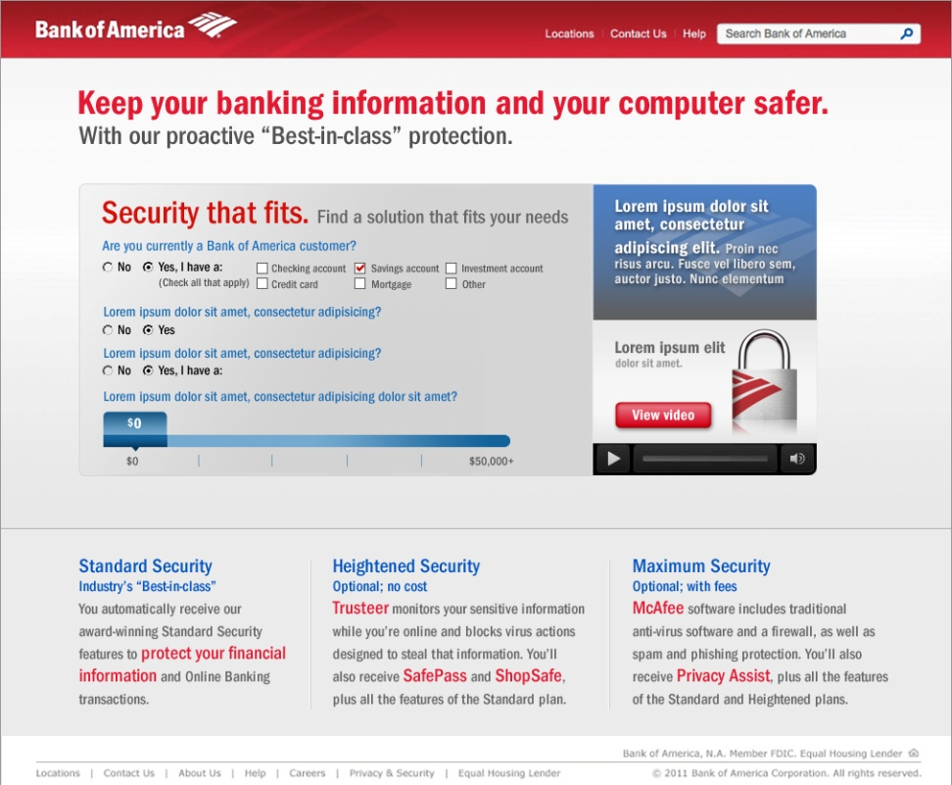
Customer Experience Maps: LP Comps
Learn: Security Video
Choose: Security Level Selection Tool
Online Security Video
In clear and customer-friendly language the video highlights the advantages of the bank’s security packages. Talks customer through the different threats and matches products to those threats.
Security Package Selection Tool
Either in partnership with the Online Security video or as a standalone tool, the Security Selection Tool will assess customers’ online usage and recommend a security package.
Q₁
Q₃
Q₂
Q₄
S₁
S₂
S₃
S₁
S₂
S₃
Enterprise Creative Solutions

Slide 12
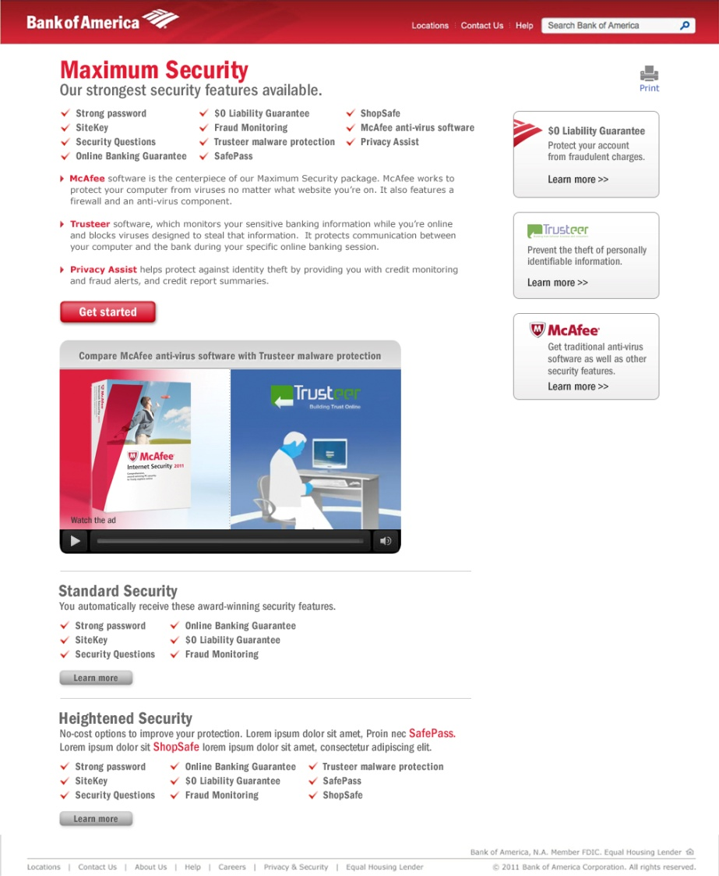
Individual Security Package: Heightened Security
Security Package Page
Presents clear, easy-to-understand, comprehensive description of the features included in the selected security package. Also offers at-a-glance views of other available packages. Soft-sell modules to the right allow customers to access in-depth feature information.
Products for the Heightened security
Awareness of the specific security products
The Maximum security visible to deepen relationships
Enterprise Creative Solutions

Slide 13
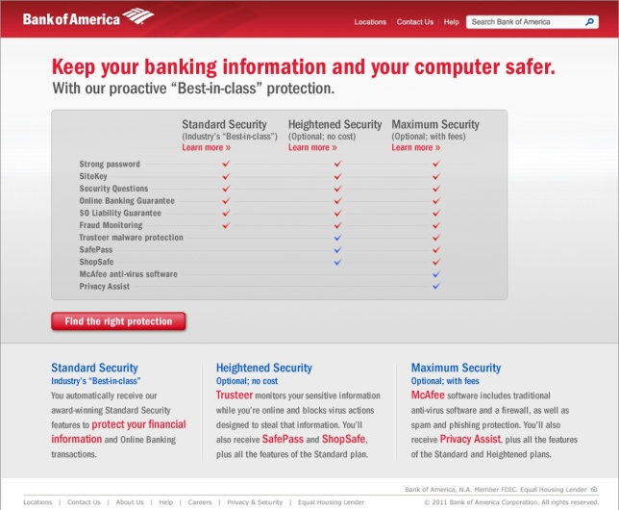
Awareness & Education vs. Checklist
Online security is complex. For the uninitiated and novice user finding the correct product mix for their level of risk is confusing. Matching products to threats requires a level of expertise the customer doesn’t have. Starting with education and a recommendation tool enables us to answer customer questions as they are asked, and leverages the trust customers already have with Bank of America. Awareness and Education leads to easy-to-understand recommendations .
Enterprise Creative Solutions

Slide 14
Appendix

Slide 15
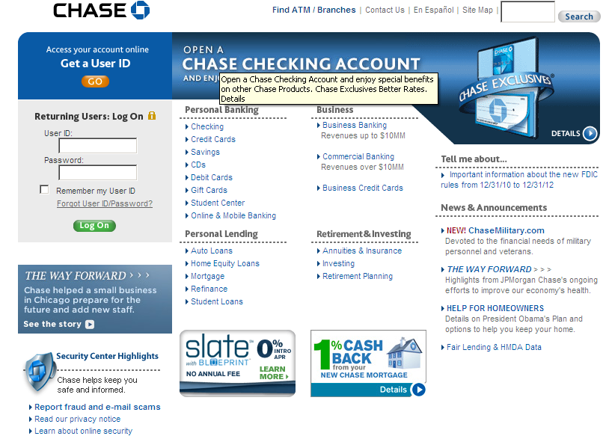
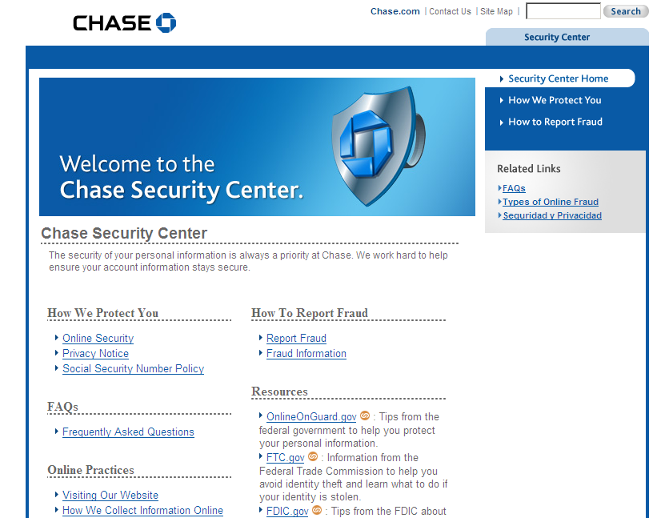
Competitive Landscape – Chase
Customers only make one click to find Security Center page
Placement on home page

Slide 16
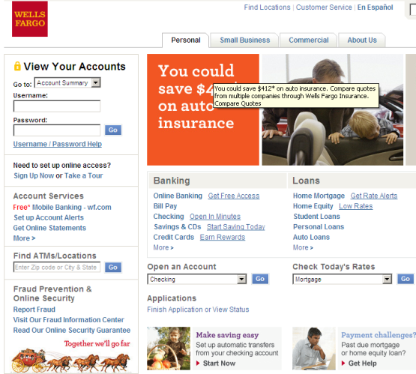
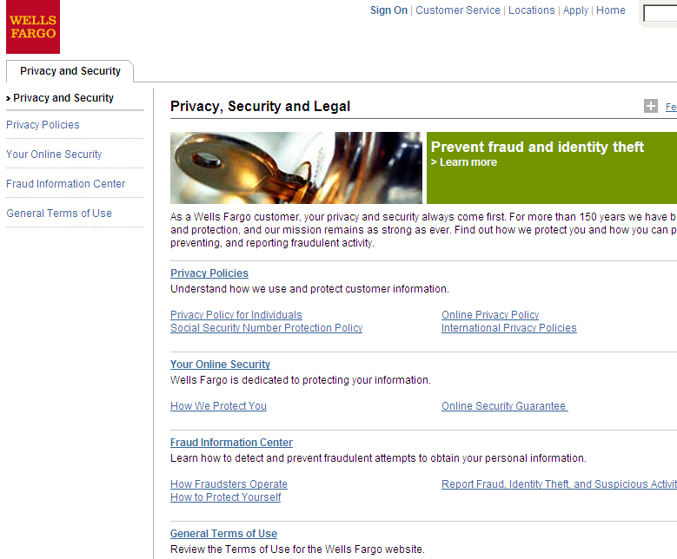
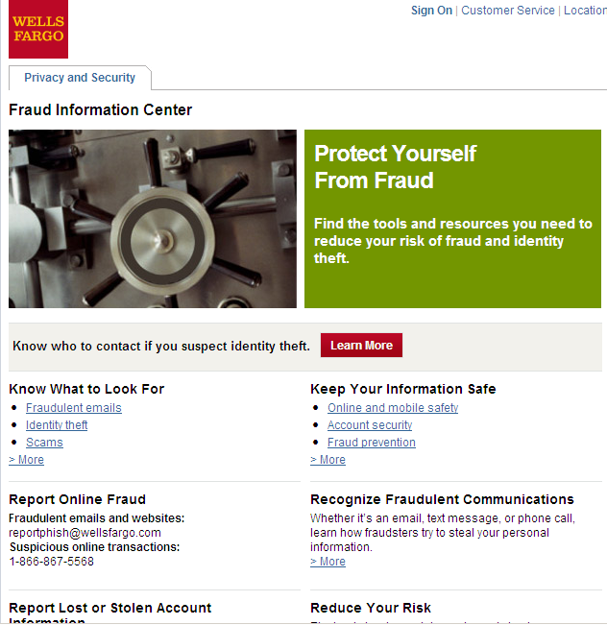
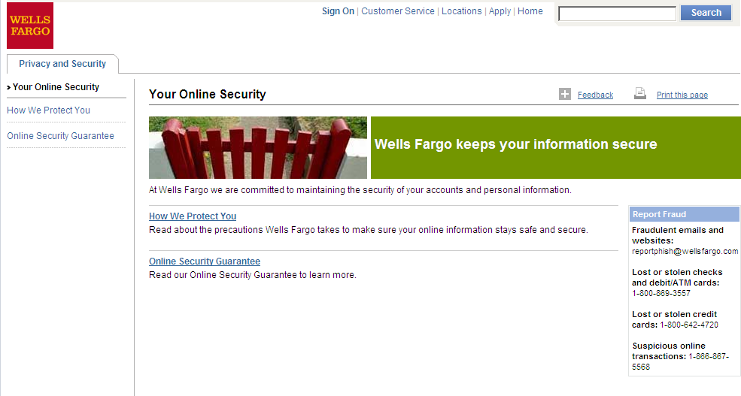
Competitive Landscape - Wells Fargo
Customers face a minimum of 3 clicks to find Online Security page – no dedicated Security Solutions page
Placement on home page

Slide 17
Digital and Non-Digital Channel Placements
High-level Channel Placements: need to be vetted
Onsite (BAC.com & Solutions.com)
Standard Campaign: BAC.com Home Page Masthead Marketing/Product Strips Landing page SASO TOLA On-Boarding Site & SASOs
Integration (links) into site content on Accounts pages
Natural Search Optimization
Solutions Site
BofA_Tips on Security
Off Site
ATM
DCN
Paid Search
Email
Non Digital Media
Banking Center
Associate Communication
Direct Response: Existing Customer Statements Channel
Existing Customer Communication
IVR/VRU on Hold Message
Enterprise Creative Solutions

Slide 18
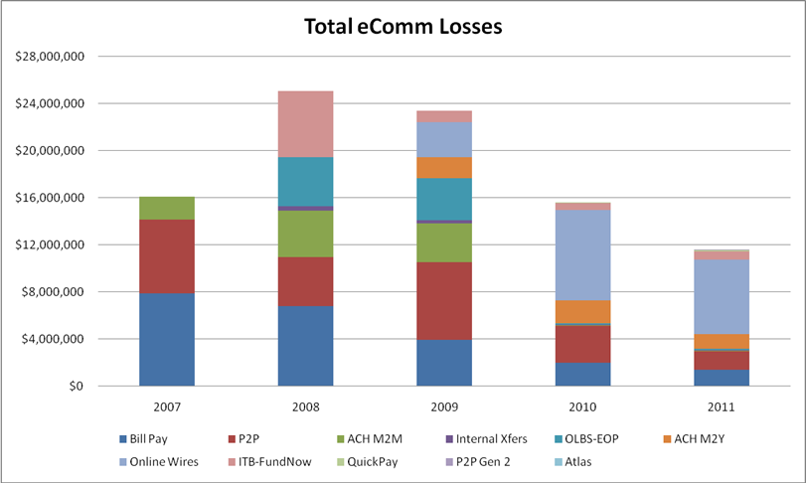
Fraud Loss Overview 2007-2011

Slide 19
Trusteer All-Play SASI – launched 3/29
As of 4/1 total of ~375K downloads!
NY Times Article March 31, 2011, 4:01 pm
Free Software to Protect Your Bank Account By ANN CARRNS
Hackers and crooks are scheming to crack Internet banking links and steal your money and personal data. So some banks are urging you to add an extra layer of protection, by using software with the somewhat tongue-twisting name Trusteer Rapport.
Bank of America began promoting Rapport to its 29 million online banking customers this week. But the bank has been quietly offering the software on its public Web site since February to anyone who wants it — free — whether they’re a bank customer or not.
The big bank joins other institutions, like Zions Bank and ING Direct, which already offer free Rapport downloads on their Web sites.
Bank of America sees a benefit in protecting as many online users as possible, Keith Gordon, the bank’s senior vice president of online security, told me this week. “We know from talking with other banks that this is not just a Bank of America issue,” he said. “It’s an industry issue. And we’re trying to be better in collaborating with other institutions.”
Mickey Boodaei, chief executive of the Web security firm Trusteer, maker of Rapport, said the software focused on guarding your browser, which links you to your bank. The program was designed in response to the emergence of financial “malware” programs, which sneak onto your computer while you’re surfing the Web and then pilfer information sent through your browser. “Fraudsters are becoming more sophisticated,” he said.
Here’s one example of the danger: When you type your user name and password, so-called key-logging malware records your keystrokes and sends them to an attacker, who can log into your account and transfer money. Rapport encrypts your keystrokes so they can’t be identified. It also verifies that you are connected to the bank’s actual Web site, and not a fraudulent copy.
Mr. Boodaei says the latest financial malware programs are believed to be emerging from criminals based in Eastern Europe and Russia. “Financial malware acts very quickly,” he said. “If you get infected today, the malware will try to transfer money today.”
Once users download Rapport, he said, they can instruct it to protect their browser at any Web site where they disclose sensitive information, like credit card sites or online shopping sites.
Using the Rapport software isn’t mandatory for Bank of America customers, Mr. Gordon said, in part because the bank already protects account holders from losses if their account is compromised. But it is advisable, he said, because malicious software programs can also steal sensitive nonfinancial information, which can be used in identity theft. “One of the goals of malware is to go gather information,” he said.
It’s still important, Mr. Gordon said, to use antivirus software and to maintain strong passwords and other security features to protect electronic information. (Bank of America offers McAfee antivirus software to its customers free for the first year and at a discount thereafter). The idea, he said, is to create multiple layers of security, to make breaches as difficult as possible. “No one piece of technology, or particular part of the process, blocks everything.”
Do you think online banking is safe? What sorts of security measures do you take to safeguard your financial information online?
19
Bank of America: Confidential

